Slide 1

ECE 530 Cloud Computing
Ioannis Papapanagiotou
Docker

Slide 2
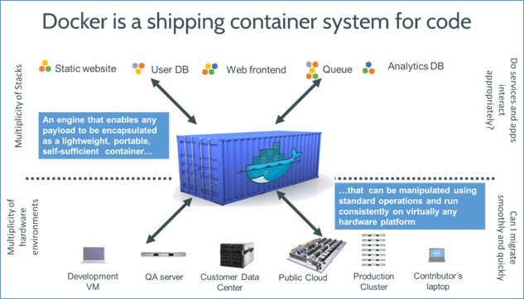
So what is Docker?
Docker is an open-source project that automates the deployment of applications inside software containers, by providing an additional layer of abstraction and automation of operating system–level virtualization on Linux.
Notes:
Source: wikipedia

Slide 3
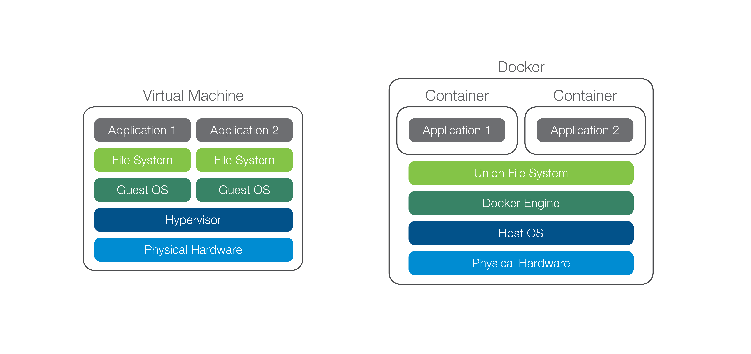
Virtual Machines vs Containers vs Docker
Notes:
A container comprises an application and its dependencies. Containers serve to isolate processes which run in isolation in userspace on the host's operating system.
This differs significantly from traditional VMs. Traditional, hardware virtualization (e.g. VMWare, KVM, Xen, EC2) aims to create an entire virtual machine. Each virtualized application contains not only the application (which may only be 10's of MB) along with the binaries and libraries needed to run that application, and an entire Guest operating System (which may measure in 10s of GB).
Since all of the containers share the same operating system (and, where appropriate, binaries and libraries), they are significantly smaller than VMs, making it possible to store 100s of VMs on a physical host (versus a strictly limited number of VMs). In addition, since they utilize the host operating system, restarting a VM does not mean restarting or rebooting the operating system. Thus, containers are much more portable and much more efficient for many use cases.
With Docker Containers, the efficiencies are even greater. With a traditional VM, each application, each copy of an application, and each slight modification of an application requires creating an entirely new VM.
As shown above, a new application on a host need only have the application and its binaries/libraries. There is no need for a new guest operating system.
If you want to run several copies of the same application on a host, you do not even need to copy the shared binaries.

Slide 4
Why Docker?
Docker makes it easy to build, modify, publish, search, and run containers.
With Docker, a container comprises both an application and all of its dependencies.
Containers can either be created manually or, if a source code repository contains a DockerFile, automatically.
Subsequent modifications to a baseline Docker image can be committed to a new container using the Docker Commit Function and then Pushed to a Central Registry.

Slide 5
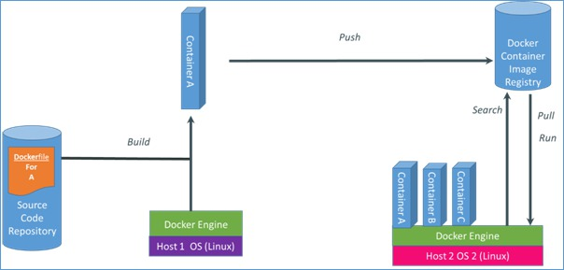
How Docker works
Containers can be found in a Docker Registry (either public or private), using Docker Search.
Containers can be pulled from the registry using Docker Pull and can be run, started, stopped, etc.
Notes:
For a full list of functions, please go to: http://docs.docker.io/en/latest/commandline/
Docker runs three ways: * as a daemon to manage LXC containers on your Linux host (sudo docker -d) * as a CLI which talks to the daemon's REST API (docker run ...) * as a client of Repositories that let you share what you've built (docker pull, docker commit).

Slide 6
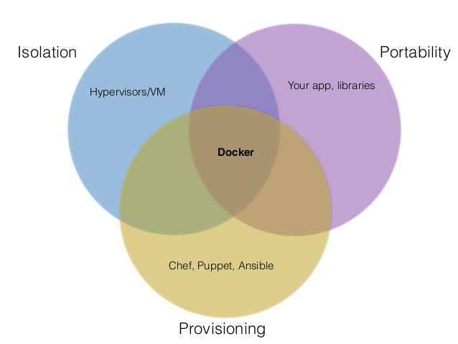
Docker Use Cases
Development Environment
Environments for Integration Tests
Quick evaluation of software
Microservices
Multi-Tenancy
Unified execution environment (dev → test → prod (local, VM, cloud, ...)

Slide 7
Hello World
Simple Command - Ad-Hoc Container
$ sudo docker run ubuntu /bin/echo 'Hello World'
Hello World
Interactive Container
$ sudo docker run -t -i ubuntu:14.04 /bin/bash
root@af8bae53bdd3:/#
Commands inside a container
root@af8bae53bdd3:/# pwd
/
root@af8bae53bdd3:/# ls
bin boot dev etc home lib lib64 media mnt opt proc root run sbin srv sys tmp usr var

